Slide 1
A PROJECT ON SMART LOCK WITH RFID AND ARDUINO
PRESENTED BY
1.M.DEEPTHI 1602-16-735-063
2.K.SHRAVANI 1602-16-735-101
3.GVS SAI SUMANTH 1602-16-735-089

Slide 2
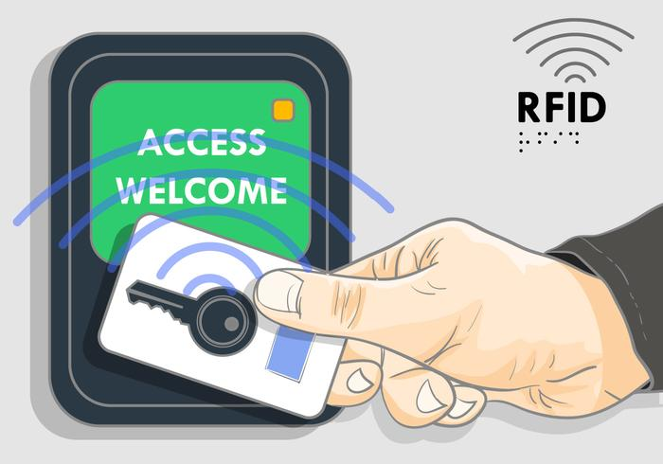
WHY RFID?
EASE OF USE.
SECURITY.
MANAGEMENT

Slide 3
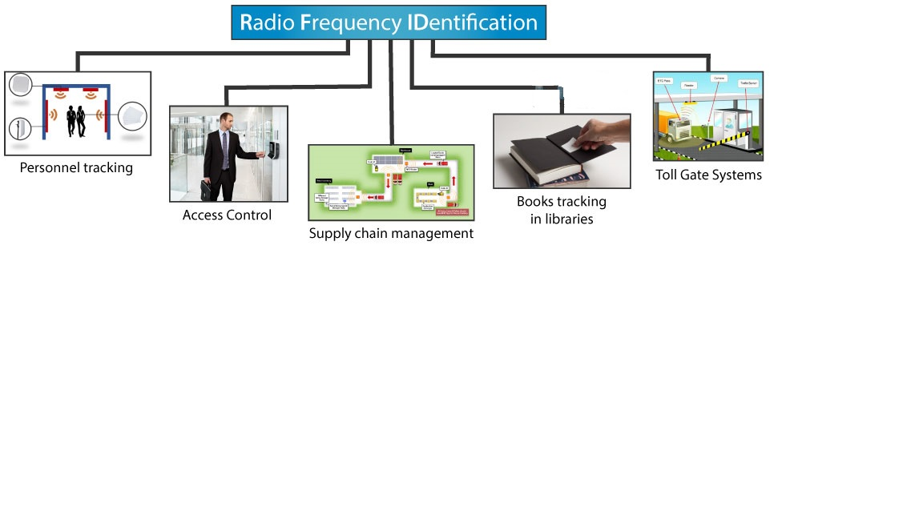
APPLICATIONS

Slide 4
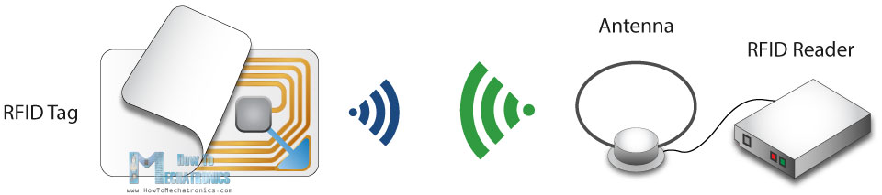
HOW IT WORKS

Slide 5
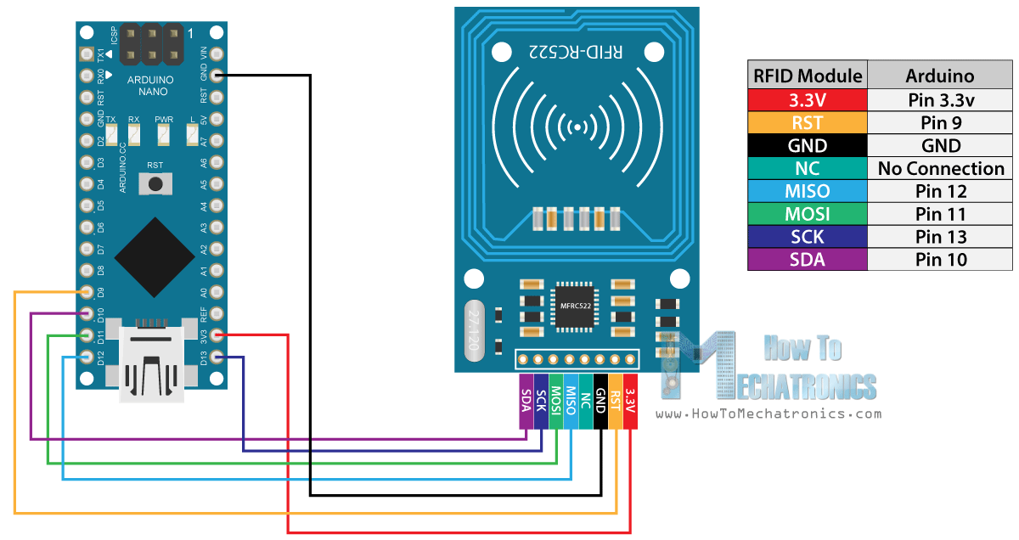
OUR PROJECT

Slide 6
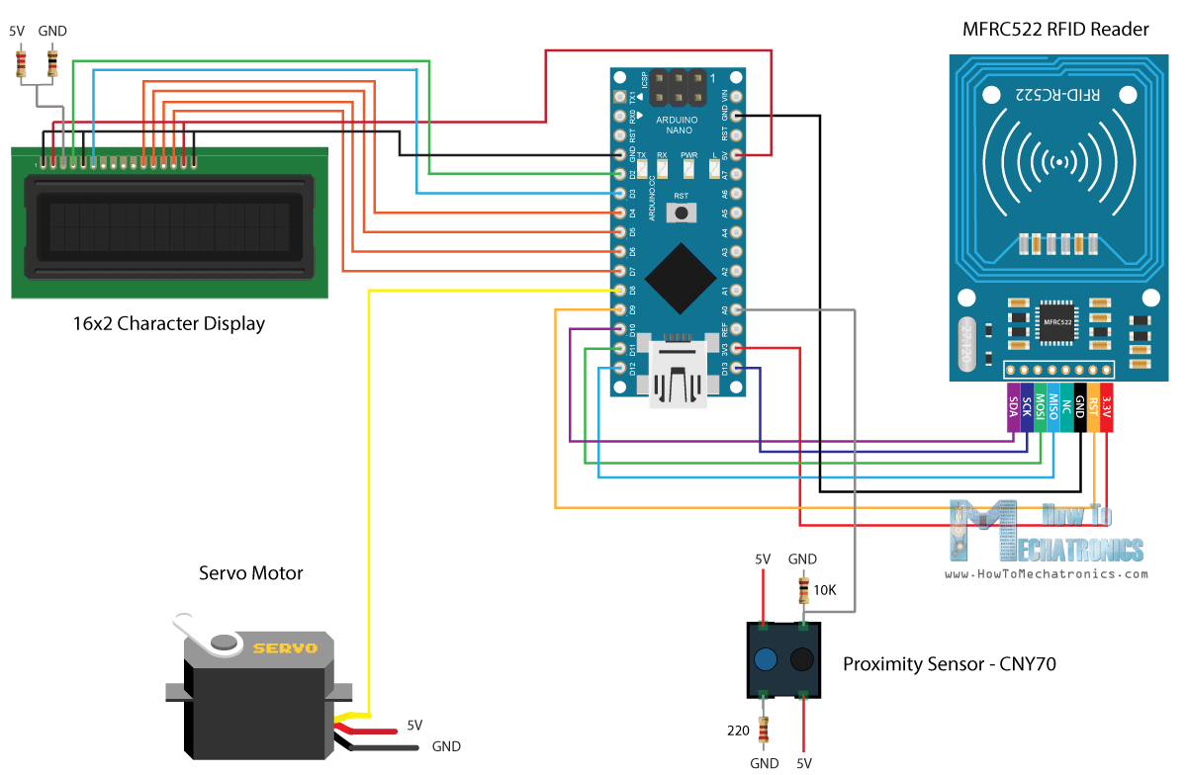
Arduino RFID Door Lock Access Control Project

